Slide 1
Photo Navigator
Chi-Chang Hsieh, Wen-Huang Cheng, Chia-Hu Chang,
Yung-Yu Chuang, and Ja-Ling Wu
Chia-Hu Chang (張嘉祜)
chchang@cmlab.cise.ntu.edu.tw
Communications and Multimedia Laboratory
National Taiwan University
ACM MM 2008
Notes:
Good afternoon, everyone.
It's my great honor to present our work here.
My name is Chang, Chia-Hu and I come from National Taiwan University in Taiwan.
The title of this paper is Photo Navigator.
We propose a system for enhancing the photo browsing experience by creating a new browsing style.
This style gives users a realistic feel as being into the scenes.
I’ll start by giving an example to show the basic idea of the proposed Photo Navigator system.

Slide 2
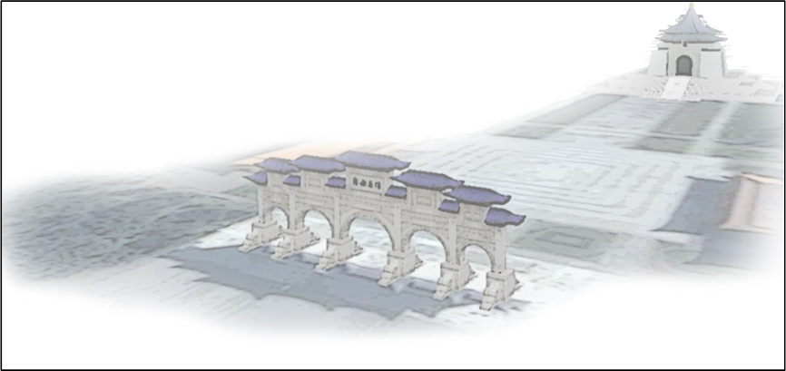
Taiwan
Chiang Kai-shek Memorial Hall
Notes:
Here is Taiwan
and let's fly to the famous landmark of Taipei city in Taiwan:
the Chiang Kai-shek Memorial Hall.

Slide 3
Photo Navigator
Chiang Kai-shek Memorial Hall
Time
Notes:
In this example, (@)
a user took photos at different time and locations of the scene.
Given these unordered photographs, (@) the system will first match features to identify spatial relationships between photos.
(@) For each photo, an approximate 3D model is then constructed automatically.
(@) With these, the system suggests a proper navigation order through these photos - from A to F in this example.
Finally, Photo Navigator determines (@) ( a smooth camera path to fly through these models)

Slide 4
Photo Navigator
Notes:
(Finally, Photo Navigator determines) a smooth camera path to fly through these models
and generate a sequence of views (@) (to synthesize a navigation video for browsing these photos. )

Slide 5
Photo Navigator
Notes:
(and generate a sequence of views) to synthesize a navigation video for browsing these photos.
Here is the result. (@)
Note that the system is essentially automatic.
However, optionally, users can manually cut out foreground objects, such as the girl in photos,
to further improve the “fly-through” effect.
In this way,
the system offers a more enjoyable “being there” experience.

Slide 6
System Overview
Notes:
This is the system overview.
Photo Navigator consists of two main modules: 3D scene model reconstruction and slideshow generation.
(@)The core module is 3D scene model reconstruction
which consists of three main procedures: feature matching, 3D scene modeling, and camera alignment.
Now I’ll first describe each of these procedures in more detail.

Slide 7
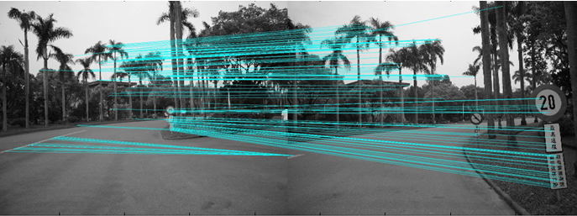
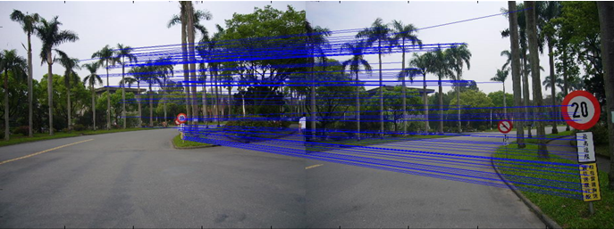
3D Scene Model Construction
Feature Matching
source image I
destination image J
Match SIFT features [Lowe, IJCV 2004]
Refine matches by using RANSAC to estimate the fundamental matrix
Notes:
Feature Matching
(@) Given a source image I and a (@) destination image J,
(@) we extract SIFT features for both images
(@) and then match these features
to identify the spatial relationships between them.
Note that such match may contain noise.
Thus,
(@)we refine the match by using RANSAC to estimate the fundamental matrix
and remove the match inconstant with the fundamental matrix.
(@) The 2D positions of correctly matched features are denoted as shown on the bottom.

Slide 8
3D Scene Model Construction
3D Scene Modeling
Build a cuboid model for the source image I
[Horry, SIGGRAPH 97]
Notes:
3D Scene Modeling
We build a cuboid model for the source image
by following the idea presented in the (@) “tour into the picture” paper.
(@)The 3D cuboid model is specified by five rectangular faces and (@)the yellow pyramid represents a virtual camera.
The input photograph is texture-mapped onto the five rectangular faces.
(@) To change the camera view will give us another view to the scene of the photograph.
(@) To map the input photograph onto the cuboid model,
the photograph is partitioned into five areas
which correspond to the five faces of a cuboid model,
rear wall, right wall, left wall, ceiling and floor.
In the original tour into the picture paper,
users need to manually specify
(@) the four points of the rear wall and (@) the vanishing point
for building this model.
In our work,
we devise methods to automatically determine those five points from image content.

Slide 9
3D Scene Model Construction
3D Scene Modeling
Find the rear wall
with largest match area and less distortion caused by boundaries
: matched features
left-right bounding
sky-ground detection [Hoiem, SIGGRAPH 05]
top-bottom bounding
Notes:
First we show the way to determine the boundaries of the rear wall.
(@)
For a source image I with matched features among it, we use (@) the leftmost and (@) the rightmost matched features respectively as the (@) left and (@) right boundaries of the rear wall.
Then,
(@) we use the method which is described in this paper to detect (@) sky and (@) ground area.
We set (@) the top of the non-sky area within left and right boundaries as the upper boundary of the rear wall
to prevent distortion caused by the ceiling.
Similarly,
we assign (@) the bottom of the non-ground area within left and right boundaries
as the base of the rear wall.
(@) In this way, we obtain the 2D position of the rear wall in this image.

Slide 10
3D Scene Model Construction
3D Scene Modeling
Find the rear wall
with largest match area and less distortion caused by boundaries
left-right bounding
sky-ground detection [Hoiem, SIGGRAPH 05]
top-bottom bounding
Notes:
( In this way, we obtain the 2D position of the rear wall in this image. )

Slide 11
3D Scene Model Construction
3D Scene Modeling
Find the vanishing point
with a better match to the detected ground area
larger area of the region
Multi-scale search
Exhaustive search at the smallest level first
Notes:
The next step is to find the vanishing point within the rear wall.
A less-carefully-placed vanishing point might cause terrible distortion
when walking through the model.
Therefore, we have to define criterion for selecting the vanishing point to avoid such distortion.
(@) For a hypothetic vanishing point, (@) we can obtain these four lines.
We define the (@) detected ground region as G and (@) this region as U.
It is apparent that (@) a vanishing point with larger area of the region means a better match to the detected ground.
We want to maximize (@) the correct match “the intersection of U and G” and (@) minimize the false match “the intersection of U and non-G”.
Thus, we maximize this criterion.
(@) Instead of exhausted search over all possible points within the rear wall,
we use a multi-scale search to find this kind vanishing point within a search area.

Slide 12
3D Scene Model Construction
3D Scene Modeling
source image I
After automatically determining
the 2D positions of the rear wall
the vanishing point
→ Initial camera pose：
[Cao, VRCIA 04]
→ Camera projection matrix：
→ 3D coordinates for each 2D feature :
Notes:
After automatically determining the rear wall and the vanishing point, we have constructed a cuboid model and estimated the initial camera pose.
Here, a camera pose is specified by its rotation and translation.
Their parameters can be estimated by using the method proposed by this paper.
We can also obtain the corresponding camera projection matrix and the 3D coordinates for each 2D feature.

Slide 13
3D Scene Model Construction
Camera Alignment
To switch from browsing I to browsing J as seamlessly as possible
destination image J
Levenberg-Marquardt algorithm
Gauss-Newton algorithm
Final camera pose
Cuboid model of source image I
Initial camera pose
Notes:
Camera Alignment
(@) In order to switch from browsing I to browsing J as seamlessly as possible, (@) Camera Alignment is performed to (@) find the final camera pose.
This problem can be formulated as (@) this optimization.
That is, we want (@) the projected position of features under a specific camera pose to be close to (@) its corresponding feature position in the image J.
(@) This problem can be solved by Levenberg-Marquardt algorithm and Gauss-Newton algorithm.

Slide 14
System Overview
Notes:
With the aforementioned 3D Scene Model Reconstruction,
given two photographs,
we can obtain (@) a cuboid model,
(@) the initial camera pose and (@) a final camera pose
for the best photograph transition.
(@) Next I’ll describe the slideshow generation and begin with the photo ordering.

Slide 15
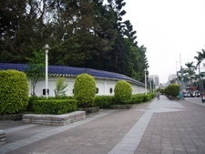
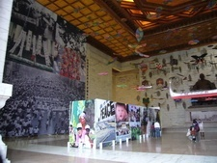
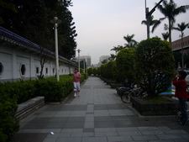
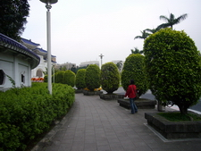
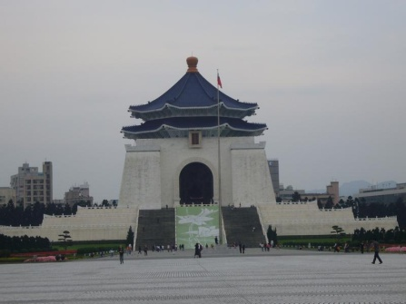
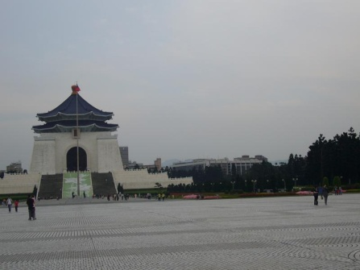
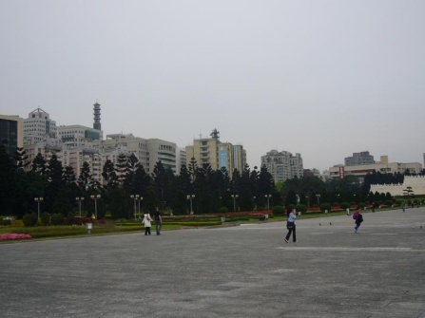
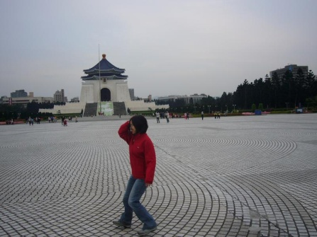
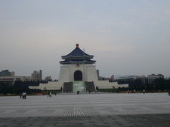
Photo Ordering
destination image J
source image I
Notes:
The basic process of Photo ordering is to find the best destination image to follow a source image from the input photo collection.
For example, given a collection of unordered photos, (@) after selecting the starting point, (@) we match features across the source image and the remaining images.
Then we discard images (@) which have insufficient matched features with source image.
(@) For each of the remaining photos,
( we estimate the corresponding camera motion type from source image to destination image by using the camera alignment procedure. )

Slide 16
Photo Ordering
y
y
y
y
forward
pan
rotation
crouch
x
> > >
x
x
x
z
z
z
z
destination image J
y
x
z
source image I
Notes:
(For each of the remaining photos, )(@) we estimate the corresponding camera motion type from source image to destination image by using the camera alignment procedure.
In our system, (@) we classify the camera motion as 4 types: forward, pan, rotation, and crouch.
(@) We assign different weightings to the four kinds of camera motions (@) in the order of preference to encourage camera motion spending more time on our preferred motion styles.
(@) So this one is the best destination image in this example.

Slide 17
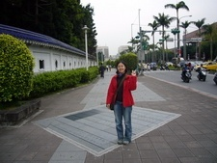
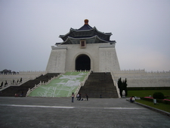
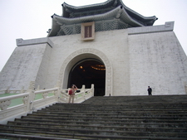
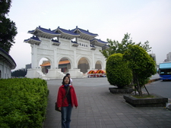
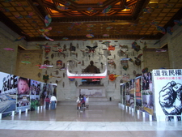
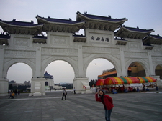
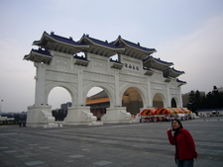
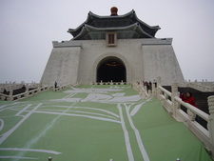
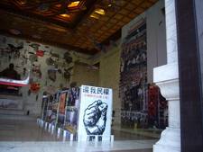
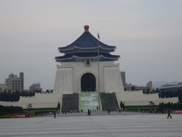
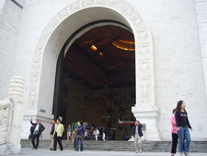
Photo Ordering
Notes:
In this way,
(@) the photo ordering process automatically arranges these unordered photos
by their spatial relationships
and generates a camera path for them.

Slide 18
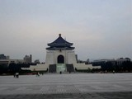
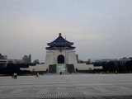
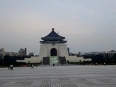
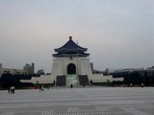
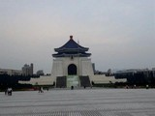
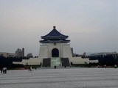
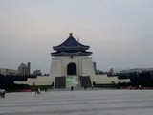
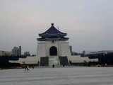
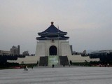
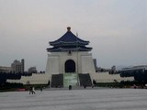
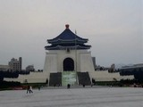
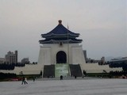
Speed Control
...
...
Notes:
Once we have determined a camera trace for photos, (@) a series of views to fly-through these photos can be rendered according to a specific walking speed.
(@) Here shows an example with a constant walking speed.
Although simple, it seems a little boring.

Slide 19
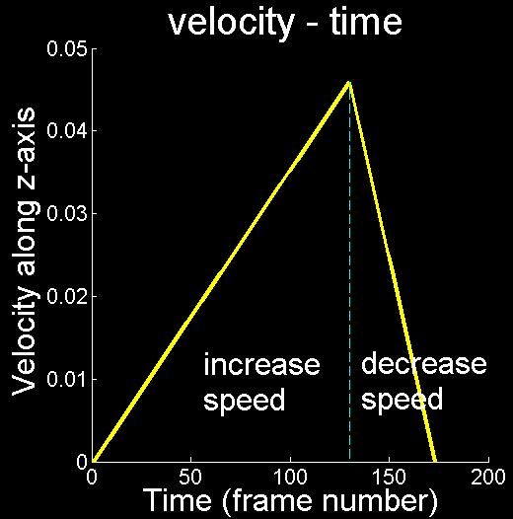
Speed Control
Emphasize the “fly-through” effect
Notes:
Instead of walking in a constant speed, we increase the speed in the first three quarters of time interval and decrease the speed in the last quarter of time interval to further emphasize the “fly-through” effect.
(@) Here I show the result.
Now it looks better.

Slide 20
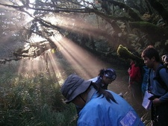
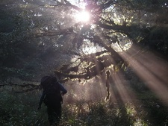
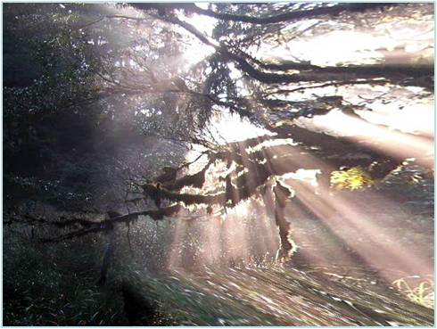
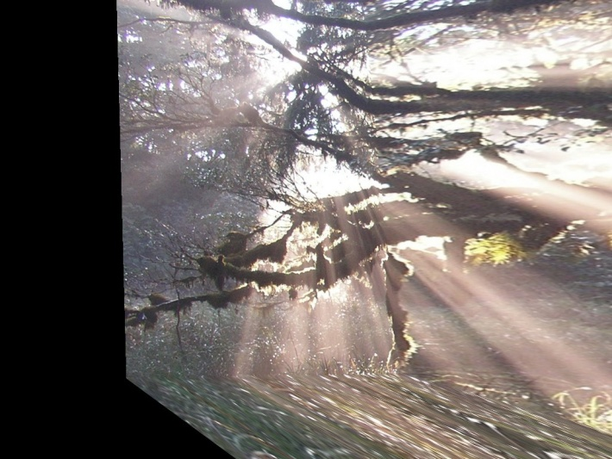
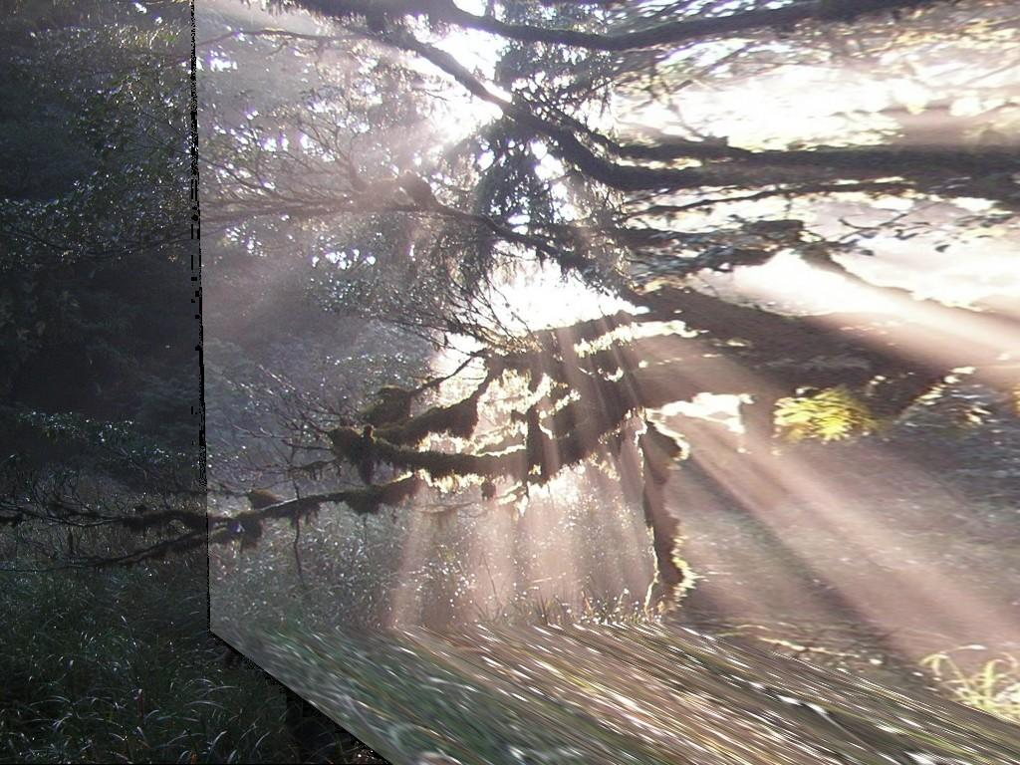
Post-processing
source image I destination image J
Black area is filled by destination image J
Cross fading
Cross blending
Cross fading + frame + camera shuttering
Notes:
Post-processing is applied to further improve the visual quality.
For example, from this source image to this destination image, (@) when the rendering of the model
under some camera pose
does not cover the whole image,
(@) the black area is filled by destination image.
Furthermore,
(@) in order to smooth this edge, (@) cross-blending is performed along the boundary.
(@) During the transition,
the rendered view is cross-faded to the next image gradually.
In addition,
(@) we add photo frame and camera shuttering effect for each photograph to provide a wonderful contrast between photos and rendered virtual views.

Slide 21
Music Beat Alignment
Harmonize the audio-visual effect
photo switch
beat alignment
Notes:
Moreover,
the rendered video can be accompanied with music to further improve the browsing experience.
(@) Photo switches are aligned with the nearest beat
to harmonize the audio-visual effect.

Slide 22
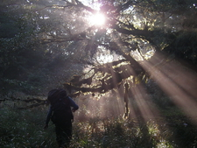
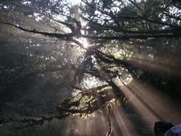
Demo
Input unordered photos:
Output:
Notes:
Here we demo the result for the Input unordered photos. (@)

Slide 23
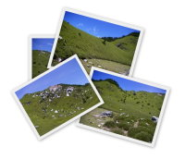
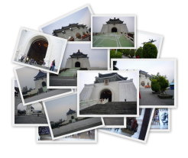
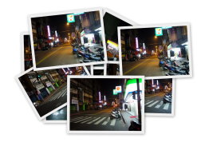
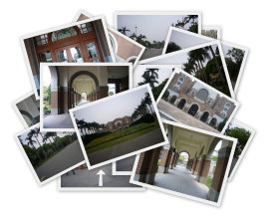
Evaluation
Set A: Landscape
4 Photos
Set B: Landscape
3 Photos
Set C: Landmark
16 Photos
Set D: Night view
8 Photos
Set E: Campus
20 Photos
Notes:
We evaluate the performance based on the five photo sets:
landscape photos in set A and set B,
landmark photos,
night view photos,
and campus photos.
Note that each photo set contains different types and numbers of unordered photos
to represent the diversity of input photo collections.

Slide 24
User Study
15 subjects interested in tour and photography were invited for the user study
We compare ACDSee, Photo Story, and Photo Navigator in terms of satisfaction
ACDSee Slideshow Photo Story Photo Navigator
Notes:
Since objective evaluation for the proposed system is difficult, subjective experiments were taken in this work.
Fifteen subjects were invited for the user study.
We used ACDSee, Microsoft Photo Story, and proposed Photo Navigator
to generate a video for each photo set.
The produced videos were presented to the subjects by projecting onto a 60-inch screen.
Here are the samples: (@) ACDSee slideshow, (@) Photo Story, and (@) Photo Navigator.

Slide 25
Questionnaire
Reality
How do you feel about the reality of the virtual walking-through?
Visual perception
How do you like the novel views between photographs?
Smoothness
How do you think about the smoothness of the transitions?
Spatiality
How strong sense of space does this sequence offer you after watching the slideshow?
Acceptance
How do you feel about the overall system?
Experience
Do you think that the slideshow helps you experience this travel and encourages you to visit?
Notes:
Evaluators were requested to grade from 1 to 10
for each video
to show their satisfactions with respect to the following perspectives: (@) Realty, (@) Visual perception, (@) Smoothness, (@) Spatiality, (@) Acceptance and (@) Experience.

Slide 26
Comparisons on Six Perspectives
Notes:
Here show the overall average satisfaction scores
of five photo sets
in terms of the six perspectives.
Note that the higher scores mean better satisfactions
and different colored lines represent different systems.
We find satisfaction score of Photo Navigator
(@) in visual perception is slightly worse than the one of Photo Story.
It is because that the 3D scene modeling which is created by Photo Navigator is not always good enough, and this induces some obvious artifacts, for example, (@)
(@) the distorted gate and (@) the mismatched object.
Nevertheless,
Photo Navigator has better satisfactions (@) than others in most perspectives,
(@) especially in spatiality.

Slide 27
Average Satisfaction Scores
Notes:
Here shows the average satisfaction scores for each photo set.
Note that Photo Navigator has much higher satisfaction scores than others.
It is apparent that Photo Navigator is suitable for various types and numbers of photos.

Slide 28
Discussions
Photo Story Photosynth
Photo Navigator
Notes:
Let’s watch the following demos to feel the different styles from these systems.
(@) This one is produced by Photo Story.
Note that the browsing order and the motions are manually reorganized to emphasize the spatial relations between photos.
(@) This one is produced by the recently released photosynth.
Note that the input photos are automatically clustered into 2 groups (@) according to the spatial relations between photos which are analyzed by the system.
(@)After clicking the play bottom,
its 3D illusion is then synthesized by switching between photos.
This one is produced by our system.
In summary, all results are very interesting
and each presents a different style for browsing photos.
Our system enriches the style set by enhancing spatiality
and creates a realistic fly-through style of transitions.

Slide 29
Conclusions
We create a new browsing style for enhancing the photo browsing experience.
The proposed system automatically reconstruct an approximate 3D model for each photo and suggest a well-routed browsing path.
It offer a strong sense of space by taking users to virtually fly into and through photos taken at the same scene.
Notes:
Conclusions
(@) We create a new browsing style for enhancing the photo browsing experience.
(@) Our system produces such an experience
by automatically creating an approximate 3D model for each photo
and suggesting a well-routed browsing path.
(@) It offers a strong sense of space
by taking users to fly into and through photos of the same scene.

Slide 30
Thank you for your attention.
Project website: http://www.cmlab.csie.ntu.edu.tw/navigator
Chia-Hu Chang (張嘉祜)
chchang@cmlab.cise.ntu.edu.tw
Notes:
You can find out more results on this website.
We hope you enjoy the proposed Photo Navigator system.
Thank you for your attention.
If the viewers have never been to the same places, they would soon feel bored for not knowing
where are worthy of seeing and just aimlessly walking around in the 3D scenes.
In such a case, they would rather passively watch a dynamic photo presentation than actively participate in it.
First, spatially close photos were not necessarily taken closely in time.
Second, users may take many photos which are close in space.
Our ordering algorithm can pick up the best ones to stitch together.
Finally, the ordering algorithm can deal with photos from other travel partners’ cameras.
Before panorama stitching tools exist, people won’t take pictures in a panoramic way.
However, once they are aware of such tools,
it becomes popular to take pictures this way if they think it is worth it.

