Slide 1
MatchMove
Digital Visual Effects, Spring 2014
Winble 2014/05/20

Slide 2
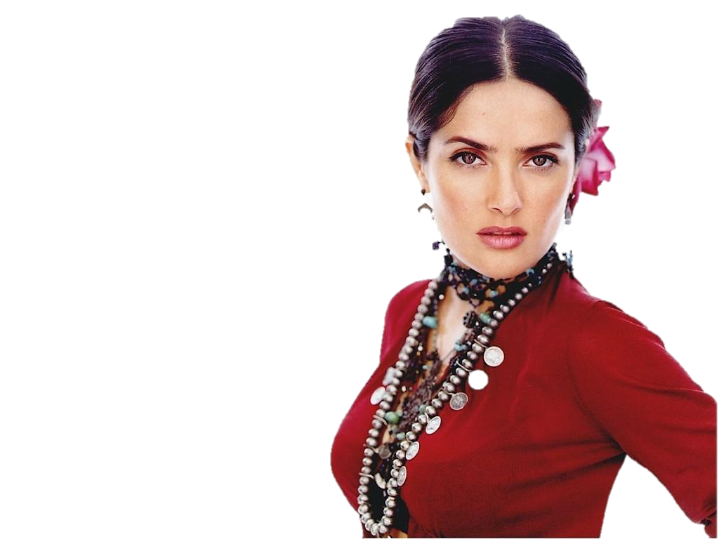
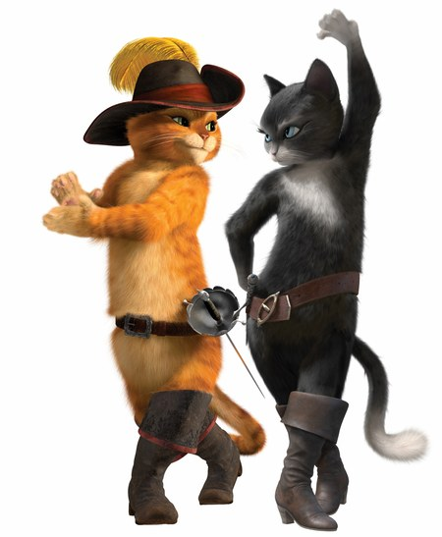
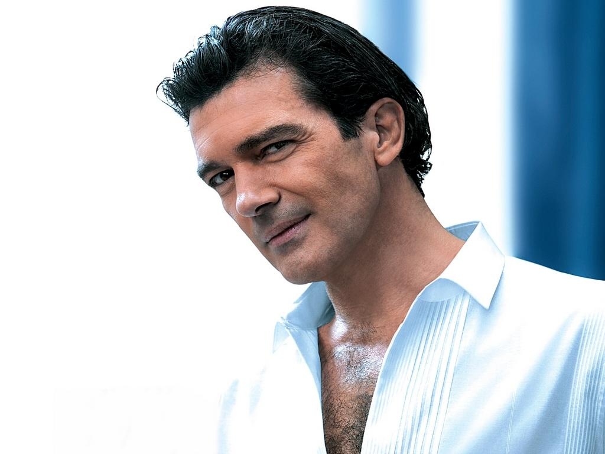
WorkFlow
Input
Video
CGI Animation

Slide 3
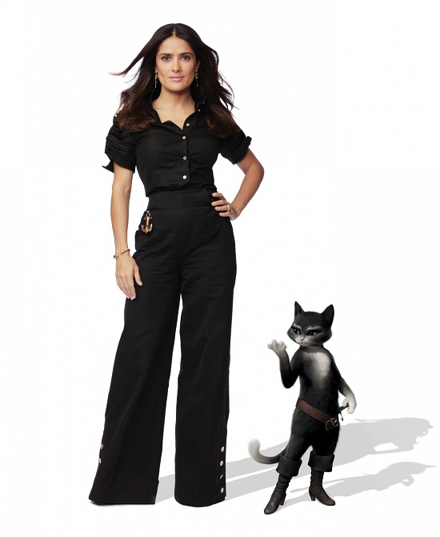
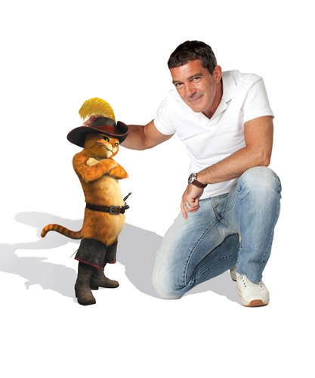
WorkFlow
Output
Composite Video

Slide 4
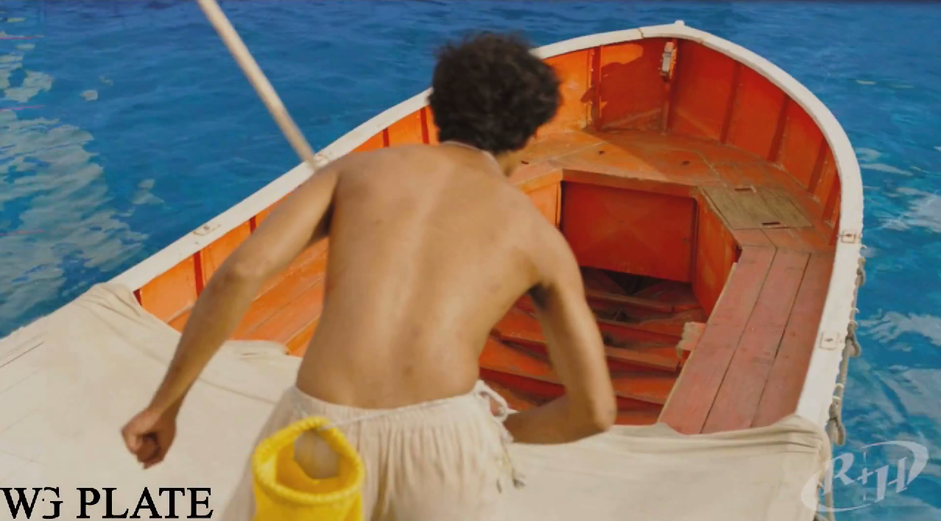
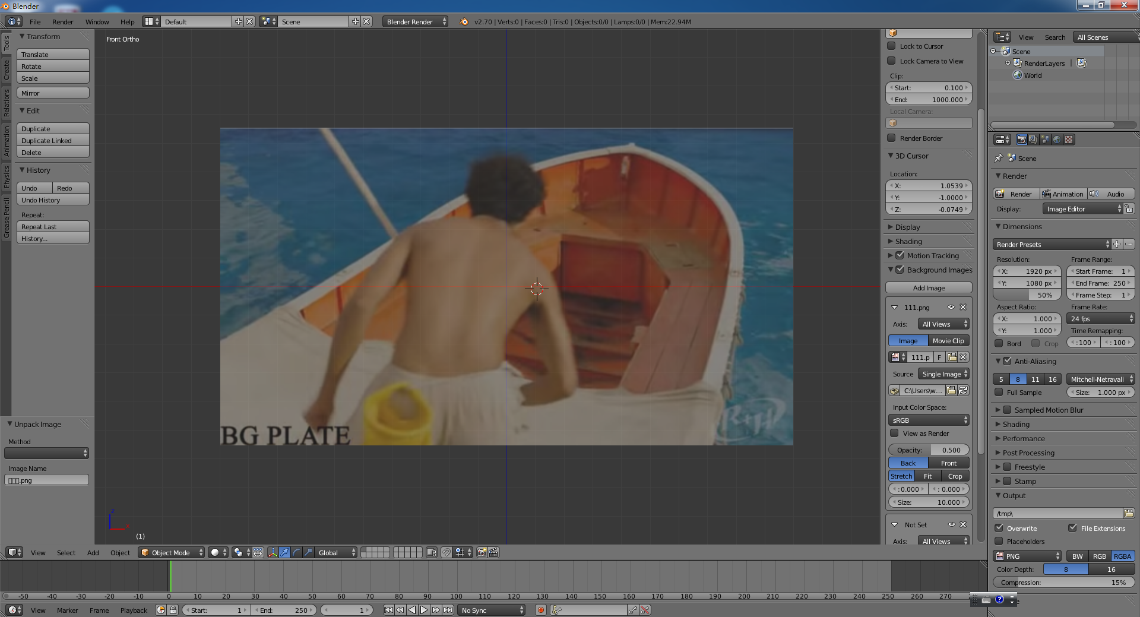
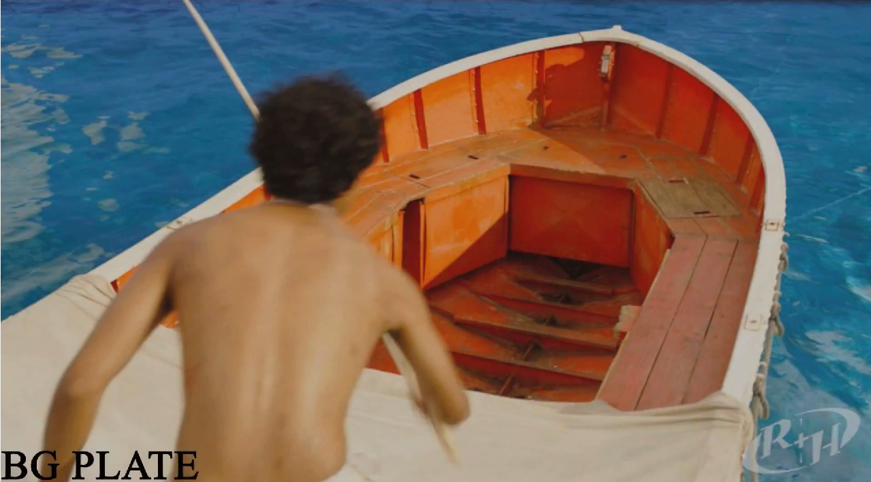
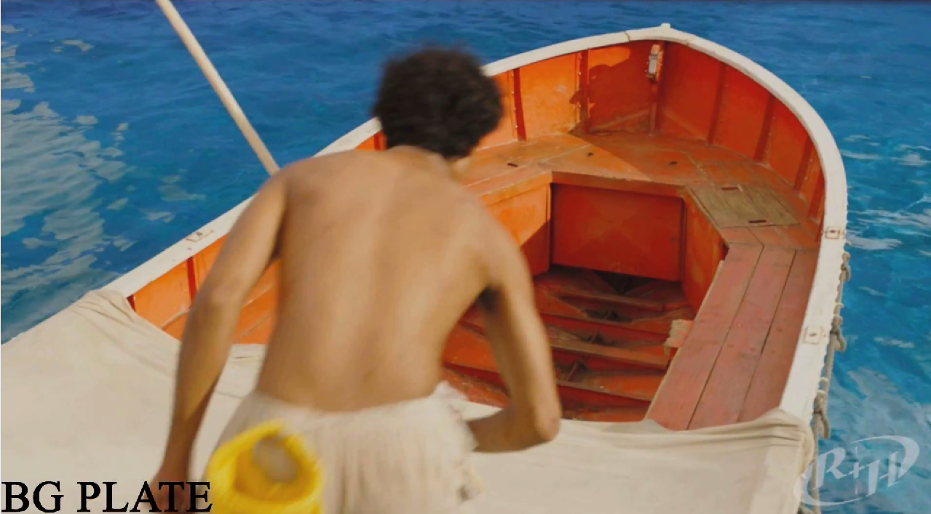
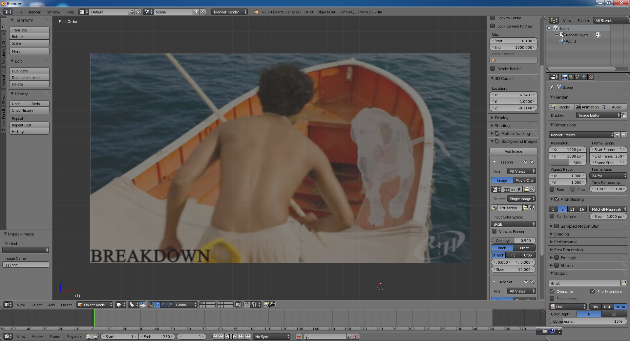
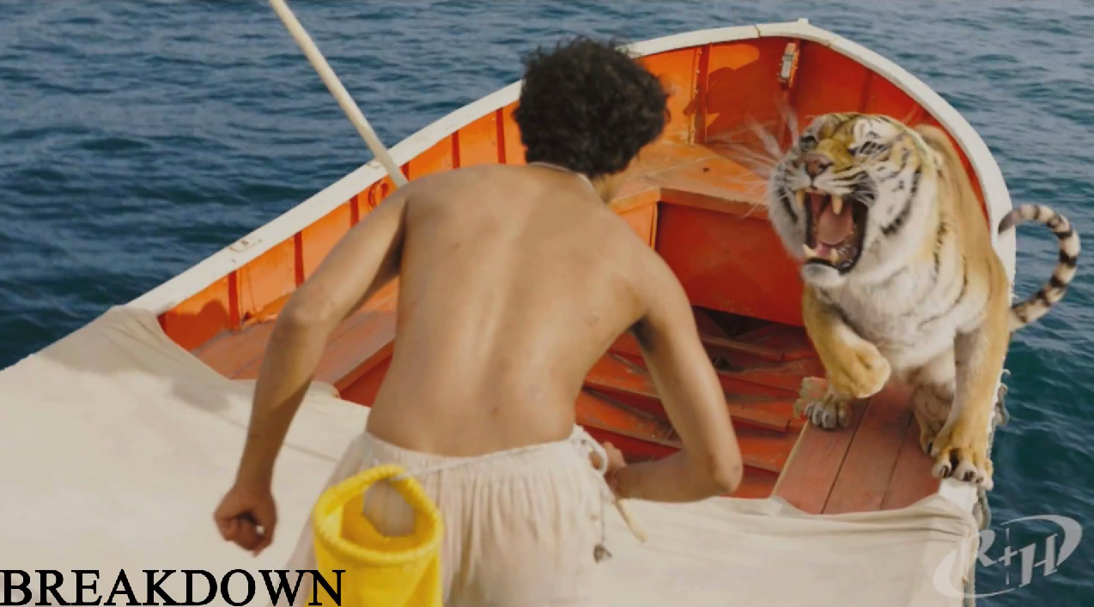
WorkFlow
Calibration
Blender
Voodoo
Video
Image sequence
MatchMove Software
Blender
Compositing
3D Model
Output Video

Slide 5
Setting
Blender
Version: 2.70a
Operating System
Windows XP/Vista/ 7 / 8 32/64 bits, Linux, Mac OS X
Web Site: http://www.blender.org/
Voodoo
Version: 1.2.0 beta
Operating System
Windows 95/98/NT/2000/Me/XP/Vista/7, Linux
Web Site: http://www.digilab.uni-hannover.de/
Other Options
Free: Blender + ICARUS
Pay: boujou + 3D Max, boujou + Maya, ...

Slide 6
Recipe: Get Image Sequence
0. Open Blender
Add Video File
Change Window Type to Video Sequence Editor
Select Add → Movie
Render Images
Choose Render Mode
Frame
Set frame size and resolution
Choose output file type (Targa)
Time interval → Select start and end of the sequence
Choose output directory
Click Animation button

Slide 7
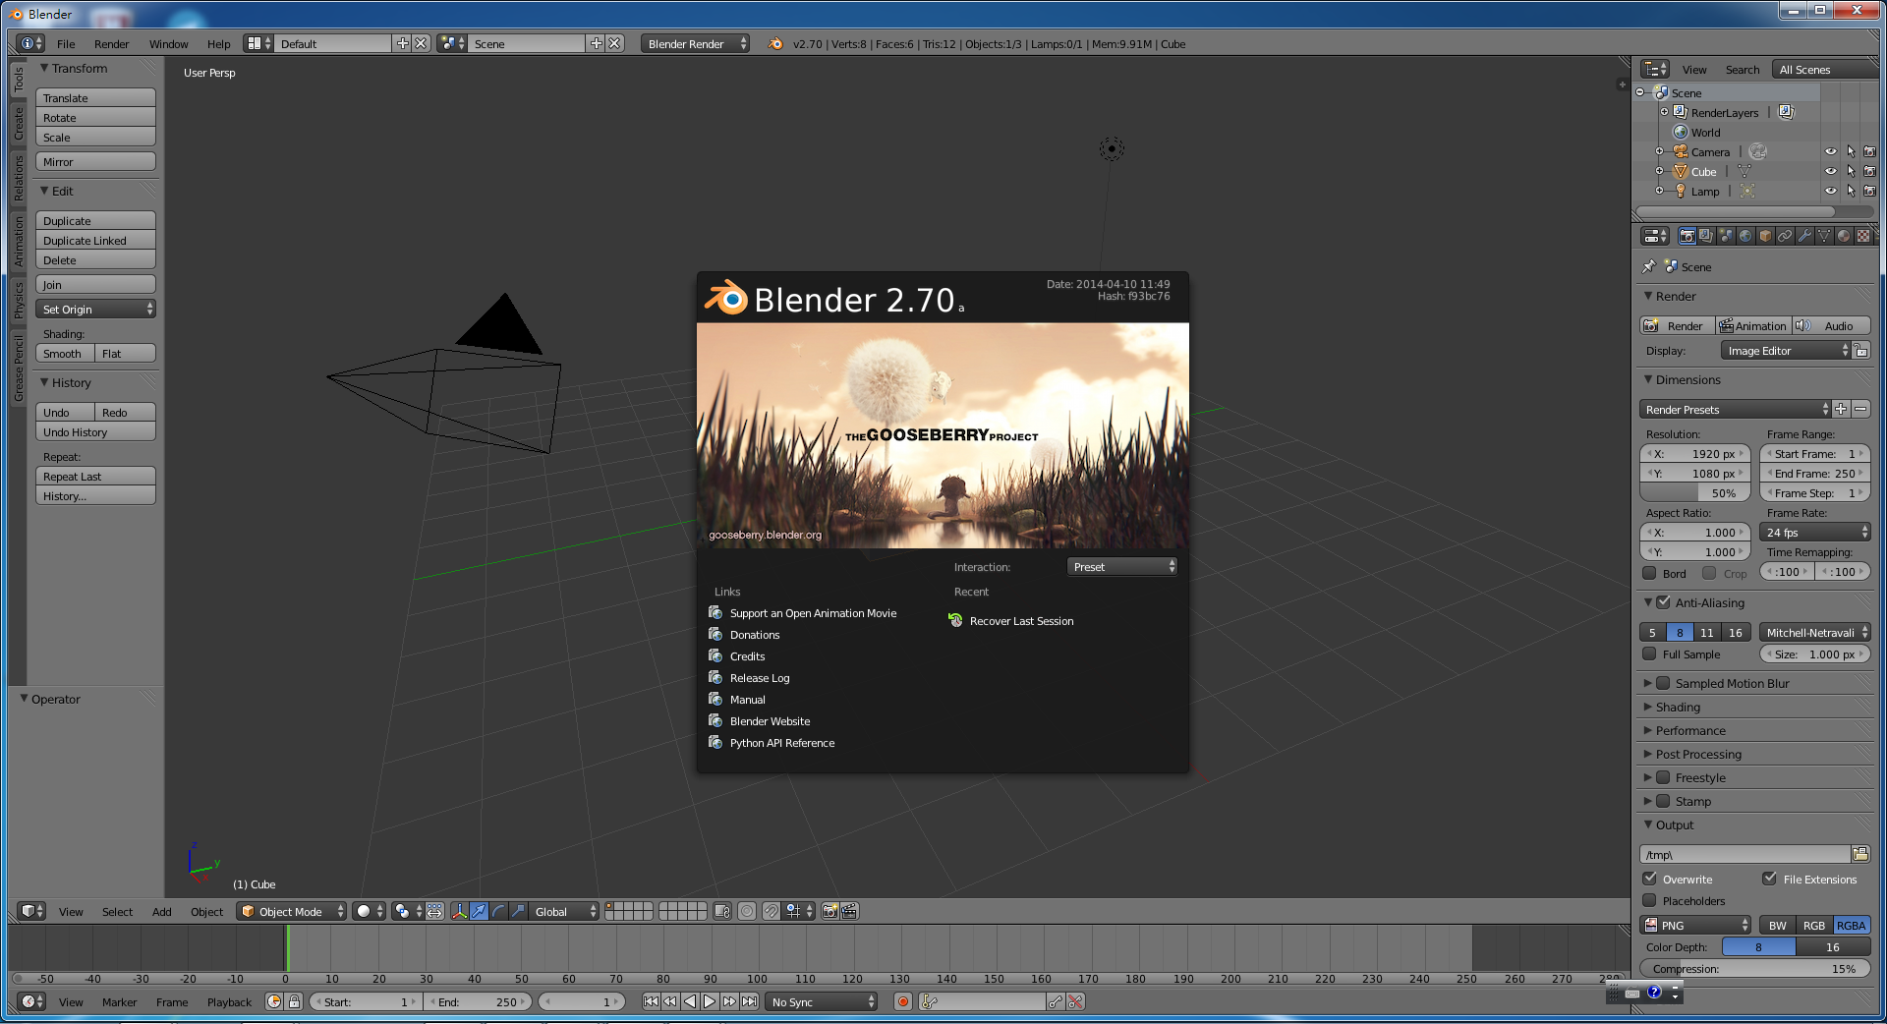
Step 0 : Blender Interface

Slide 8
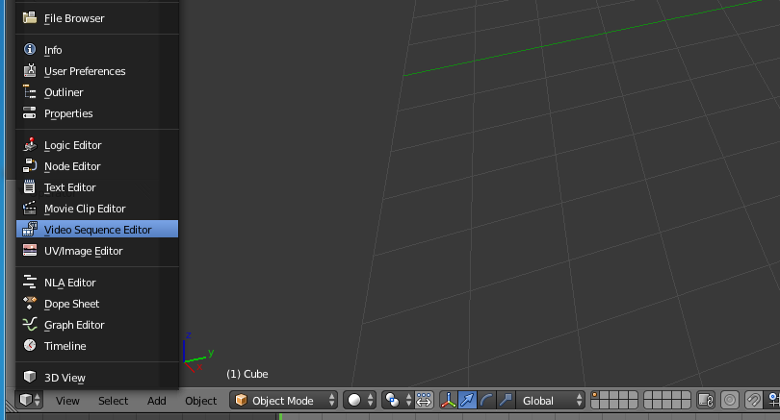
Step 1 : Add Video File
Change to Video Sequence Editor
Click here to change window type

Slide 9
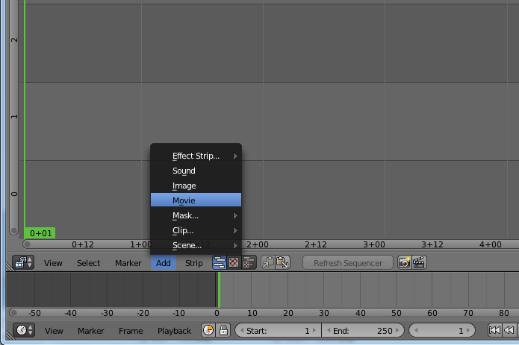
Step 2-1 : Add Video File
Add → Movie

Slide 10
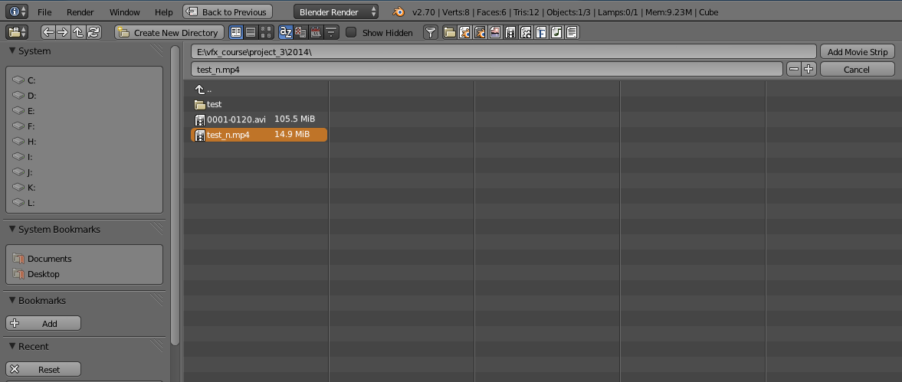
Step 2-2 : Add Video File
Add video file
Select input video file
Select file directory

Slide 11
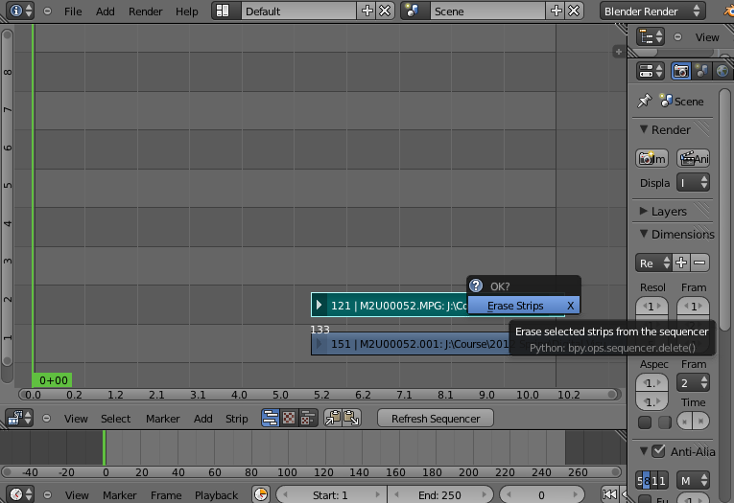
Step 2-3 : Add Video File
This is the sound track. Since we only need images for feature tracking, you can choose to remove it here, and add it back at the video editing stage!
Click “Delete” button

Slide 12
Step 2-4 : Add video file
Right-click to Drag the strip to the “1st Frame” in Layer 1

Slide 13
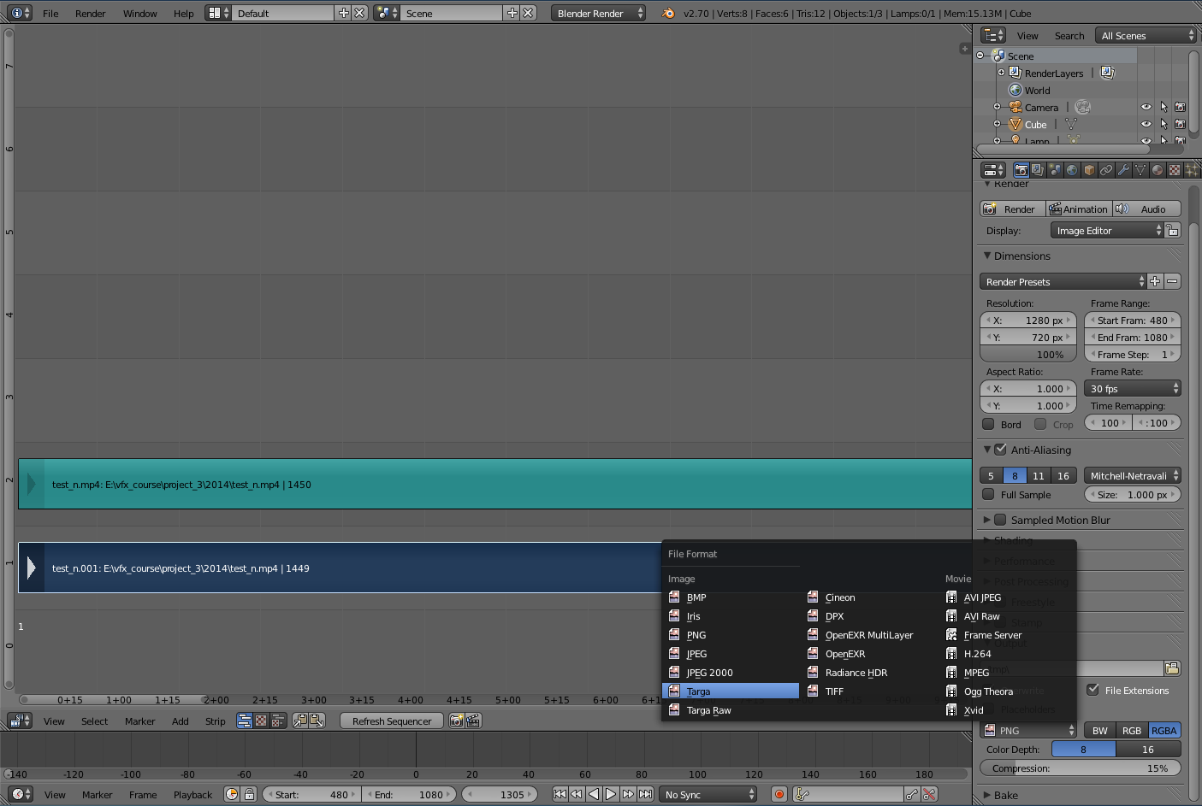
Step 2-4 : Add video file
Produce!
Set Frame size, Resolution, Frame Range & Frame rate
Choose output file type “Targa”
Set output directory
Input Audio
Input video

Slide 14
Recipe: Calibration
0. Open Voodoo
Open Image Sequence
Select File → Open → Sequence
Select the first frame
Select Move Type “Free Move”
Track → Click Track button
Export Python Script
Select File → Save → Blender Python Script
Save .py file
Choose File type “Blender 2.5x and higher (*.py)”

Slide 15
Step 1-1 : Choose Sequence
File → Open → Sequence

Slide 16
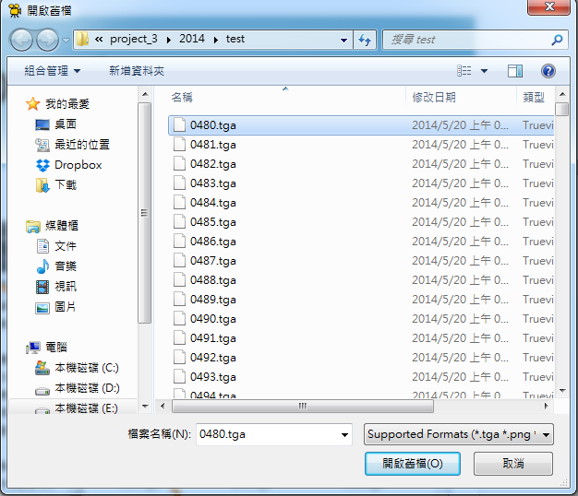
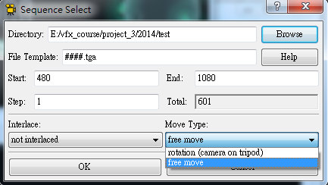
Step1-2 : Choose Sequence
Avoid unrecognized path
Choose “free move”
Note!!!
“free move” is for general moving conditions
“rotation (camera on tripod)” is for the special case with only the rotation
Select 1st frame

Slide 17
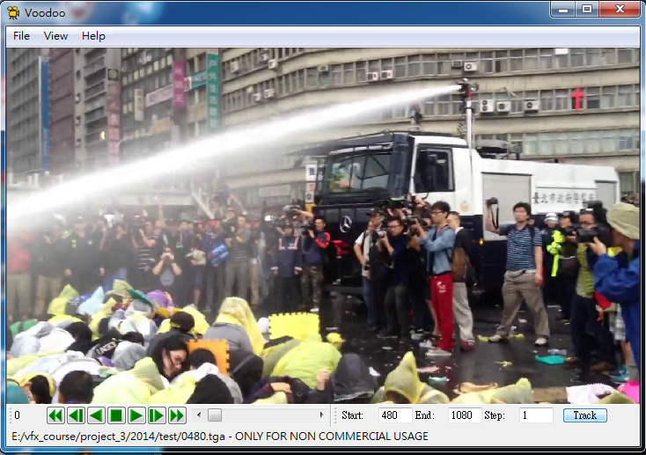
Step 2-1 : Track
Track

Slide 18
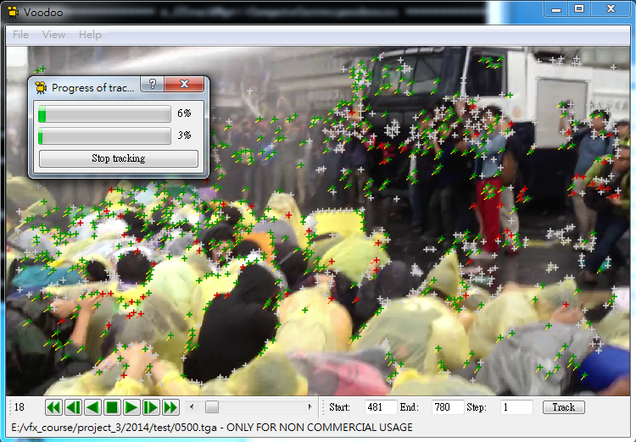
Step 2-2 : Track
Process Progress

Slide 19
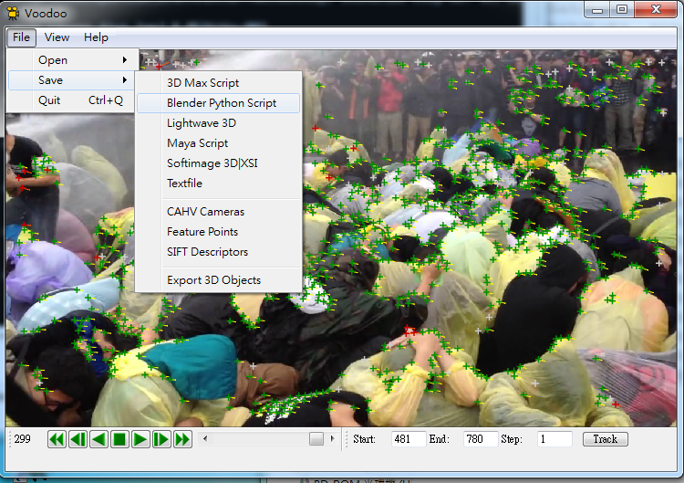
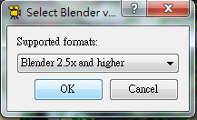
Step 3-1: Export Python Script
File → Save → Blender Python script
Choose File type “Blender 2.5x and higher (*.py)”

Slide 20
Note
I meet problems on Voodoo
Voodoo sometimes crashes due to
Too large file size
Too complicated tracking situation
The tracking result is not satisfying
Solution
Split your video into smaller clips
Use Blender (need to give camera parameters) http://wiki.blender.org/index.php/Dev:Ref/Release_Notes/2.70/Motion_Tracker

Slide 21
Recipe: Import 3D Motions
Open Blender
Delete Default Objects
Choose the object and click “Delete”
Load Python Script
Change Window Type to Text Editor
Select Text → Open Text Block
Select io_import_voodoo_camera_fix.py and Run Script
Import voodoo_camera to run previous .py file
Adjust Rendering Property

Slide 22
Recipe: Import 3D Motions
Load Background Images:
Change Window Type to 3D View
Select View → Cameras → Set Active Object as Active Camera
Load background images
Set the video parameters of background images
Change the view
View → View Persp/Ortho
View → Front
Check any frame and adjust the opacity of background images
Load models & editing their motions in the video!

Slide 23
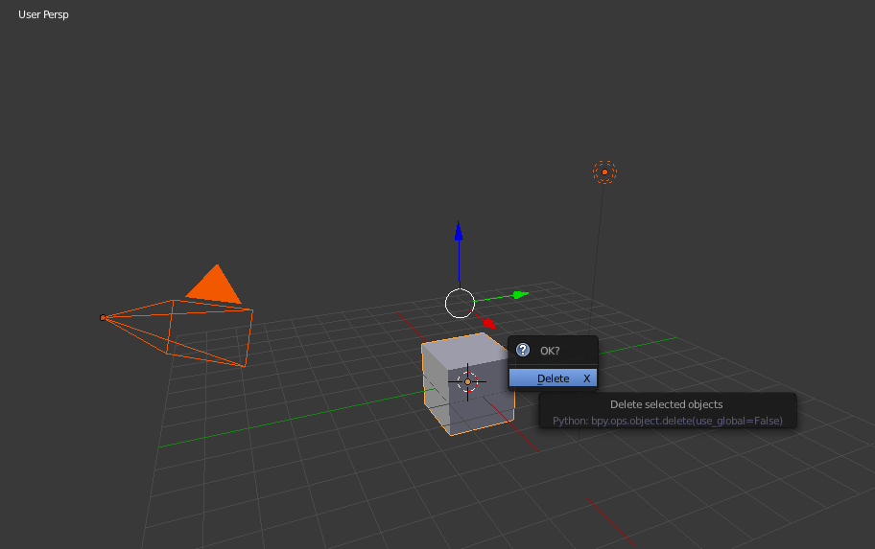
Step 1: Delete Default Objects
Press “a” twice to select all objects
Click “Delete” to erase

Slide 24
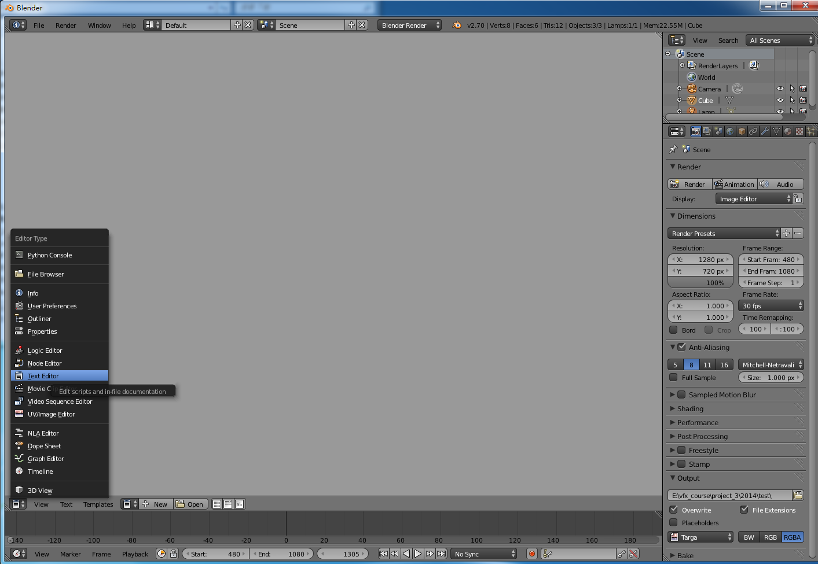
Step 2-2 : Load Python Script
Choose “Text Editor”
Text → Open Text Block
24

Slide 25
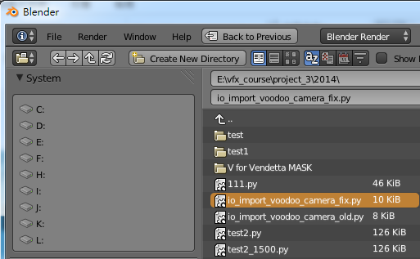
Step 2-3 : Load Python Script
Select io_import_voodoo_camera_fix.py http://ppt.cc/BNkt
Run Python Script
Notes:
For v2.68 ~ v2.70

Slide 26
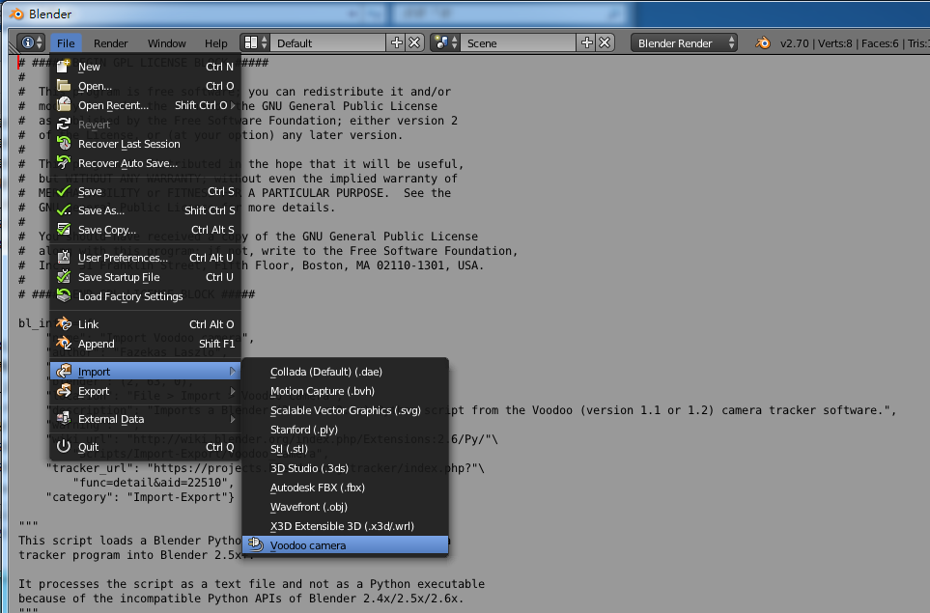
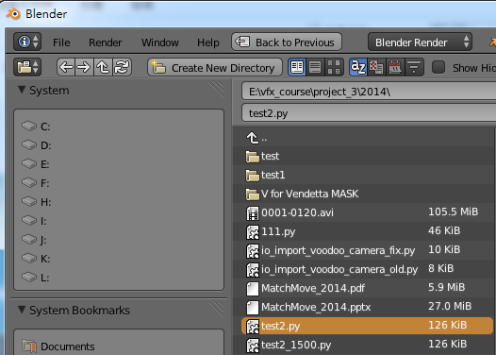
Step 2-4 : Load Python Script
Choose previous .py file
File → Import → Voodoo camera

Slide 27
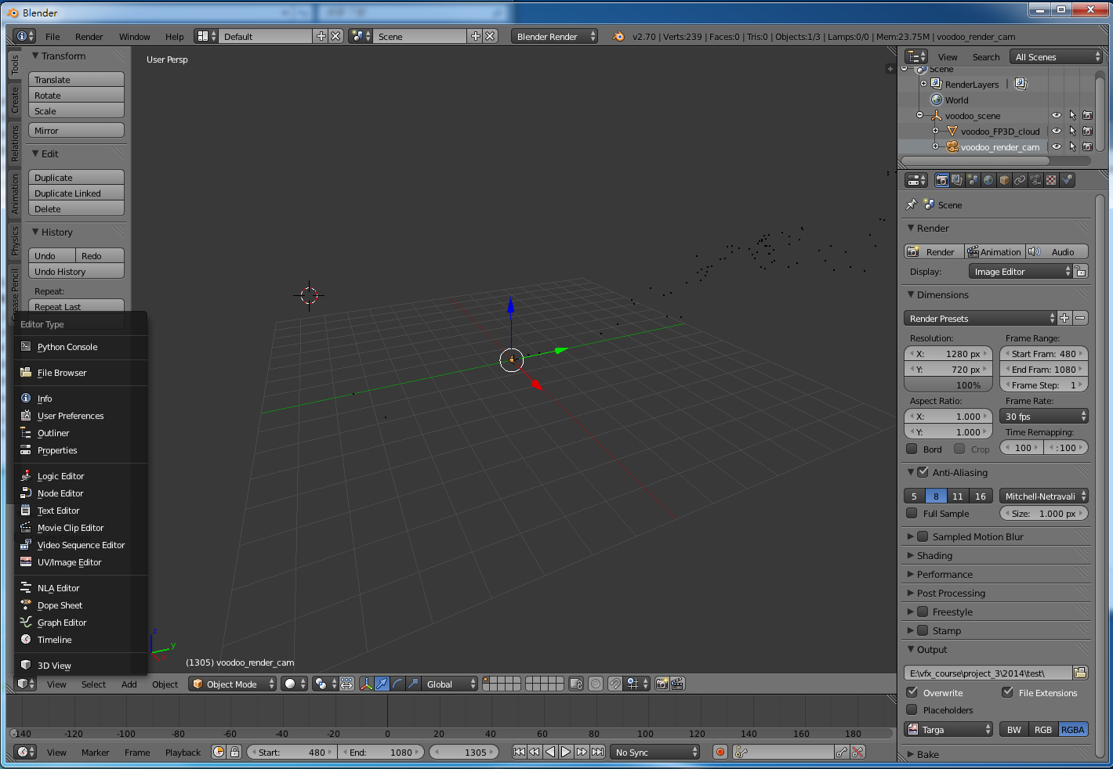
Step 3-1 : Load Background Images
Select voodoo_render_cam
Back to 3D View

Slide 28
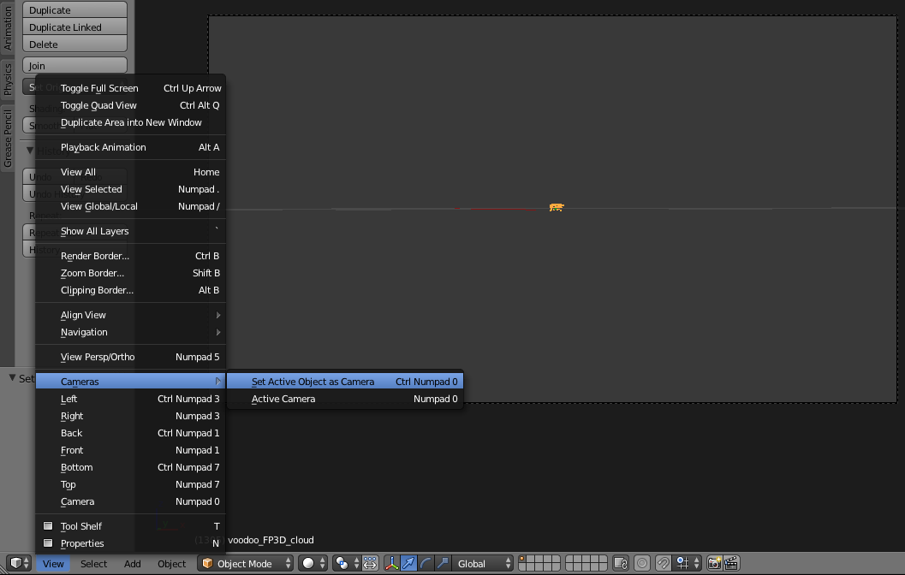
Step 3-1 : Load Background Images
Set Active Object as Camera to see the video view

Slide 29
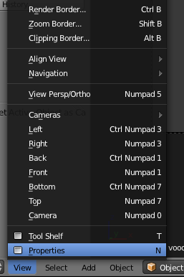
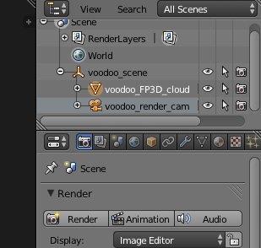
Step 3-3 : Load Background Images
Click the “+”
View → Properties
or
Notes:
Open properties panel

Slide 30
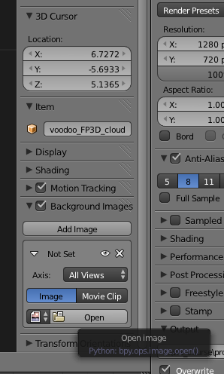
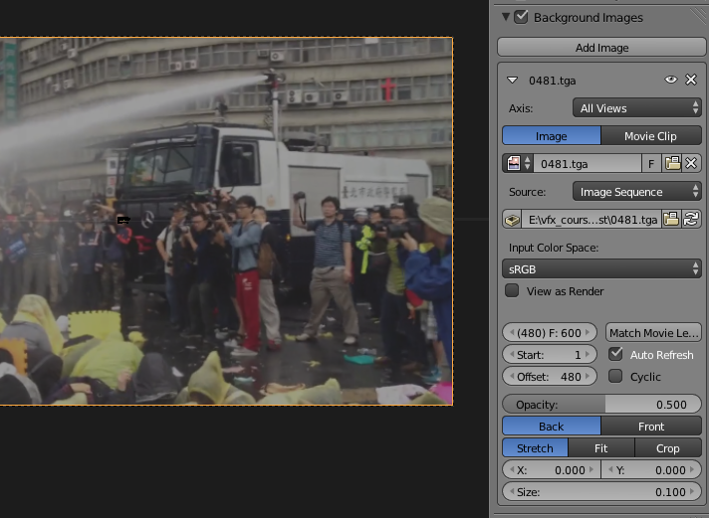
Step 3-3 : Load Background Images
Tick off “Background Images”, click “Add Image” Then Open Image Sequence/ Video Clip
Enable“Auto Refresh”

Slide 31
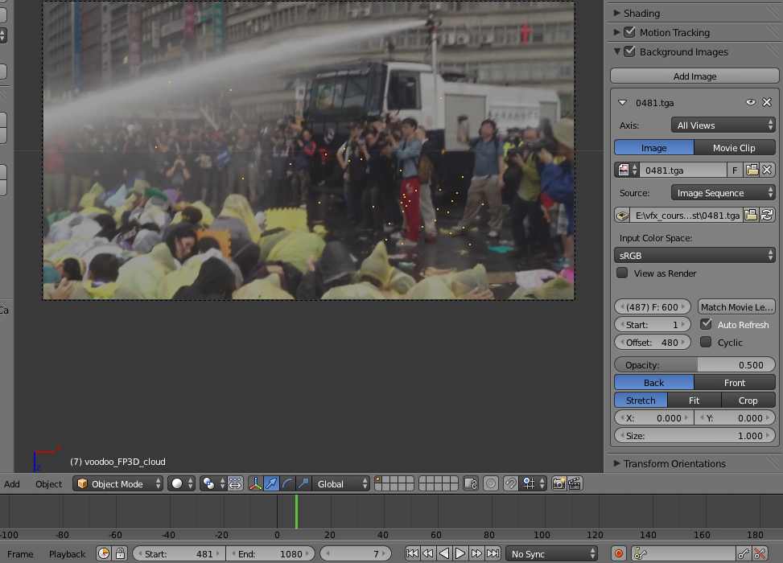
Step 3-6 : Load Background Images
You can adjust background image’s
Opacity, Scale & Position
Use any frame to check background image

Slide 32
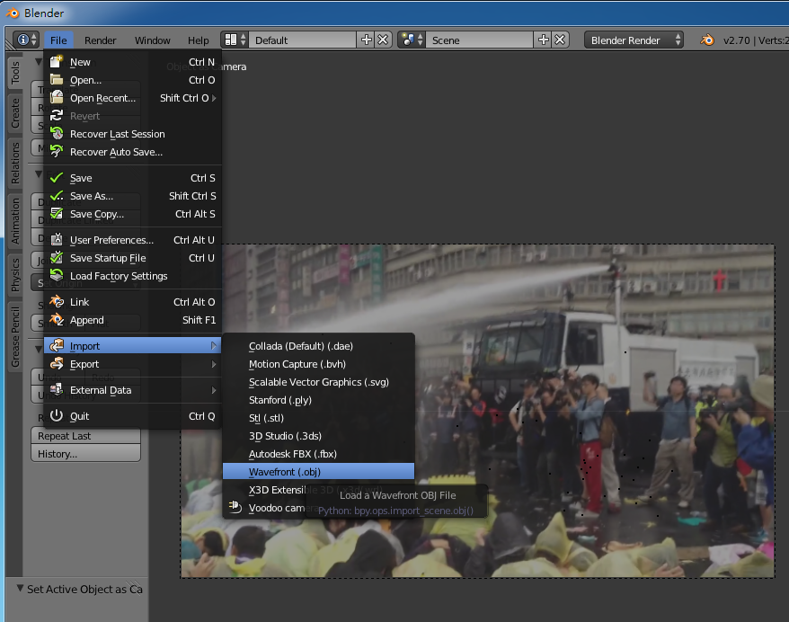
Step 5-1 : Load Models
File → Import → “Model Type”

Slide 33
Step 5-2 : Load Models
To use the model as a “single object” instead of many “small groups(components)” ,you can close the group options

Slide 34
Step 5-2 : Load Models
Model split by groups (for finer operations)

Slide 35
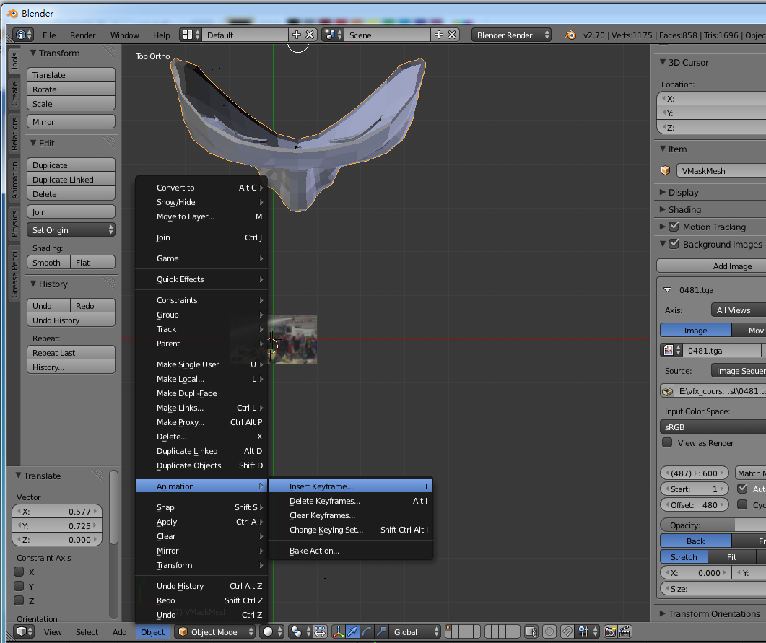
Step 6-1 : Set Keyframes
Object → Animation → Insert Keyframe…
Set the motions of your model !

Slide 36
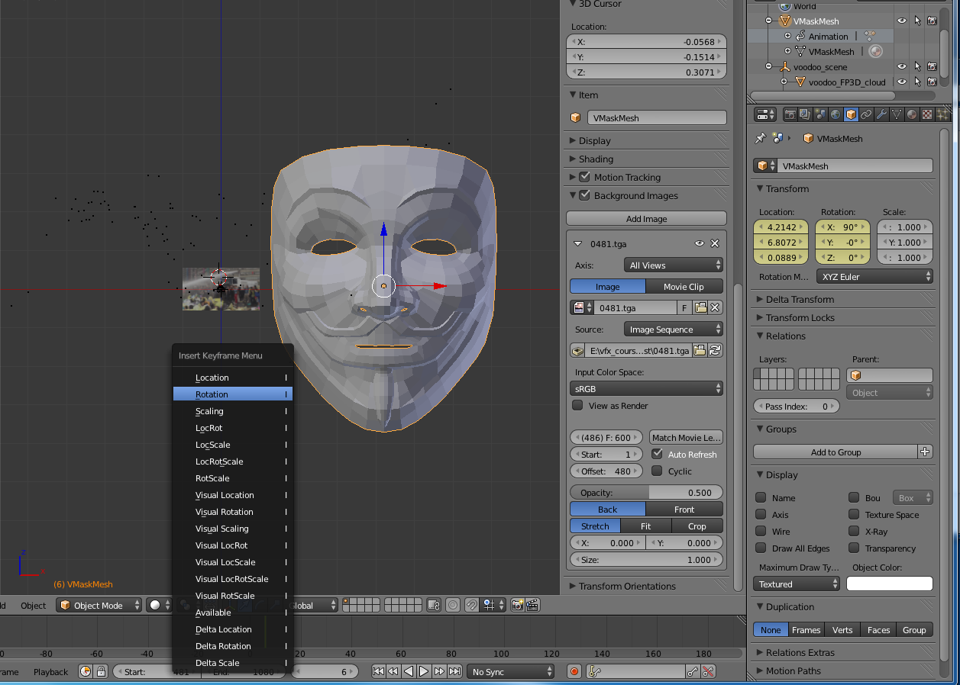
Step 6-2 : Set Keyframes
Model parameters and corresponding lock in keyframe
Lock the parameters in keyframe
Choose Object Mode
Choose keyframe

Slide 37
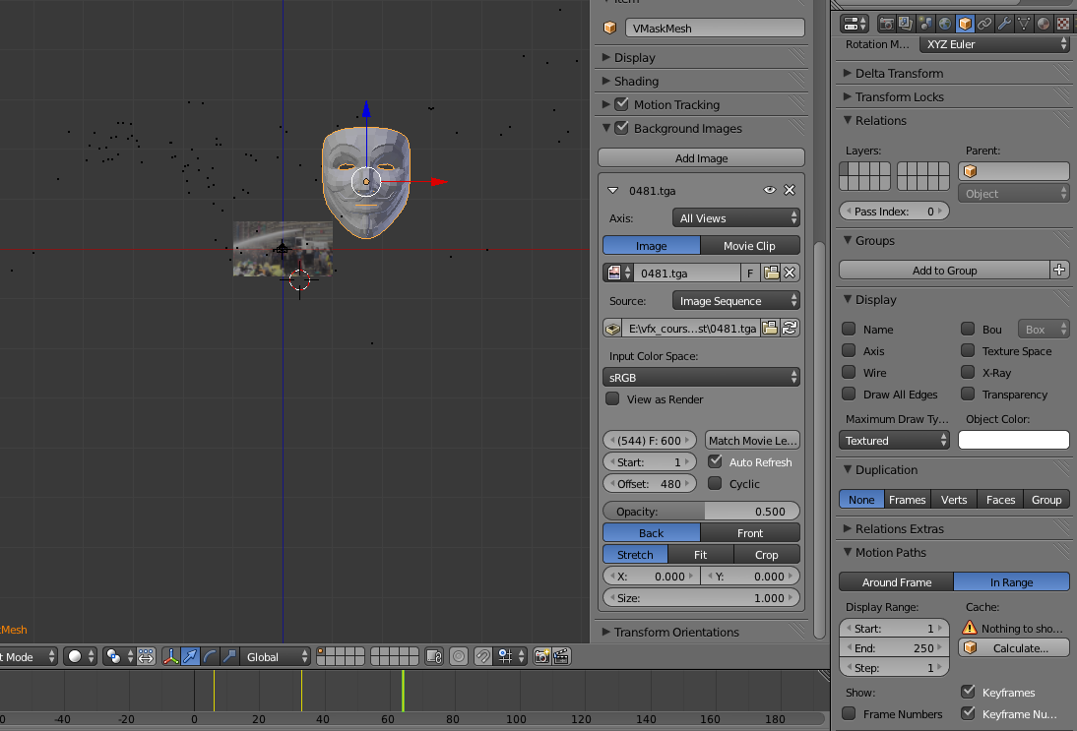
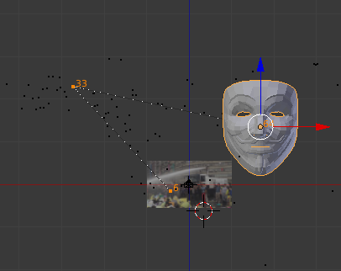
Step 6-3 : Set Keyframes
You can use Object → Motion Paths → Calculate Paths
to see the motion path of models
Motion Path
Time point of Keyframes

Slide 38
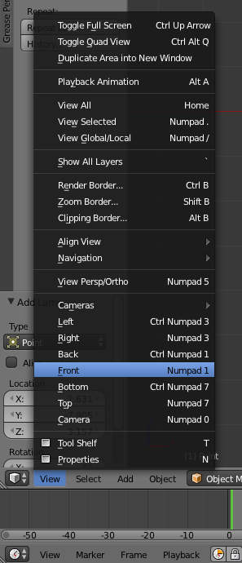
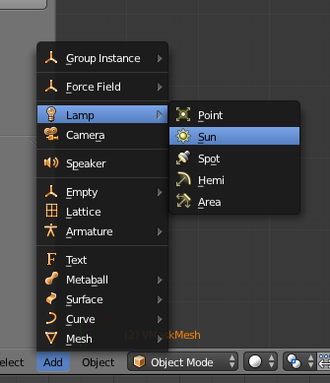
Step 6-4 : Set Keyframes
Some notes
Different camera views are helpful
Fine adjust 3D position & shape
Preview is your good friend
Ensure your model condition shown in that frame
Don’t forget the light (lamp)
Preview won’t show the lighting
Avoid model “in the dark”
Unstable model motion
Set more keyframes
Split fast-moving video into more small-period clips

Slide 39
Recipe: Compositing
Add Image Sequence
Change Window Type to Video Scene Editor
Select Add → Images and select all images
Drag the strip to the “1st Frame” in Layer 1
Add Scene
Select Add → Scene
Drag the scene strip to the “1st Frame” in Layer 2
Set Scene
Change scene property to “Alpha Over”
Set frame and video parameters
Click Animation

Slide 40
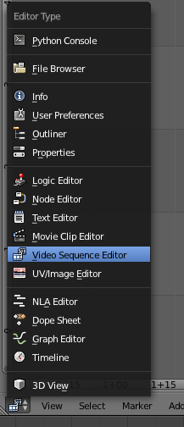
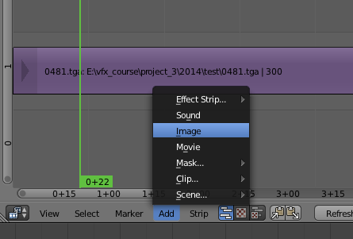
Step 1 : Add Image Sequence
Drag the strip to the “1st Frame” in Layer 1 (Right click and drag, left click to set)
Add → Image/Movie
Choose “Sequence Editor”

Slide 41
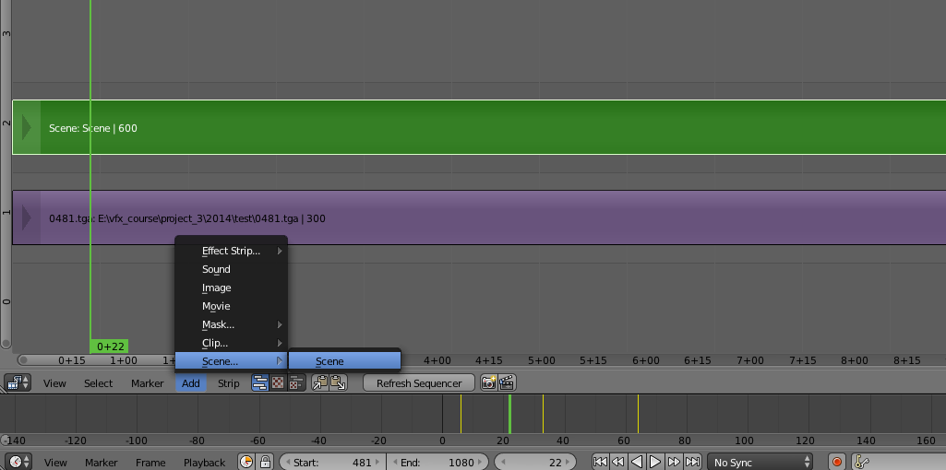
Step 2 : Add Scene
Drag the scene strip to the “1st Frame” in Layer 2
Add → Scene → Scene

Slide 42
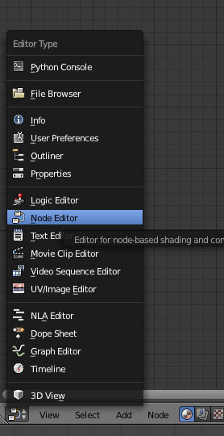
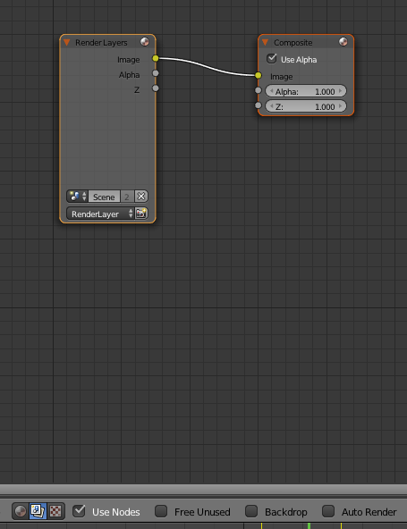
Step 3-1 : Set Scene
Chose Node Editor
Choose display/edit node tree &
Tick off “Use Nodes”

Slide 43
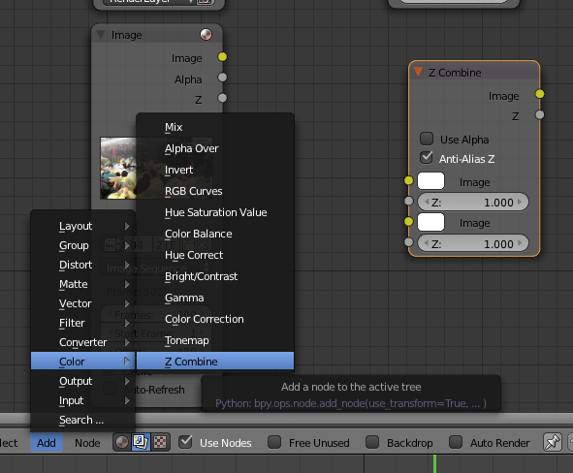
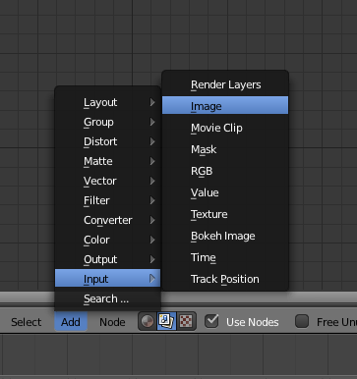
Step 3-2 : Set Scene
Add Image/Movie
Set Image Sequence
Add Z Combine

Slide 44
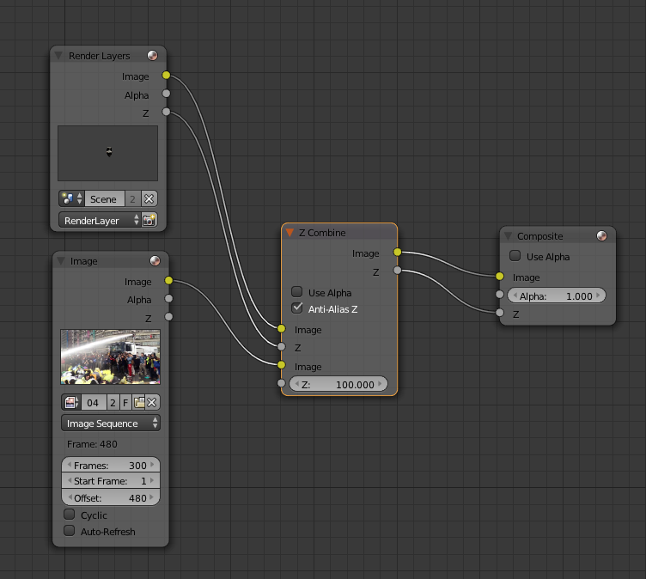
Step 3-3 : Set Scene
Adjust the step lines
Layer1
Layer2
Set image Z value (see the memo below)
Notes:
You can try linking the image z value to layer 2’s z value first.
If it’s estimated correctly, you’ll get the right animation results.
If not, you can set the z value manually, ex. 100. This value is roughly estimated through the tracking points’ z values.

Slide 45
Step 3-4 : Set Scene
Press “Render” or Select the “UV/Image Editor” to check the rendering result

Slide 46
Step 3-4 : Set Scene
Animate the final result!
Select output directory & Video type
Set video Resolution, Frame Range (time) & Frame Rate

Slide 47
Example
Life of Pi and R.I.P.D Tracking and MatchMove
https://www.youtube.com/watch?v=lE3QwDfoyp4
NTU VFX 2011 Assignment #3
https://www.youtube.com/playlist?list=PLDBC5F12DD815090D
NTU VFX 2012 Assignment #3
https://www.youtube.com/playlist?list=PLiioR5ew-ZqsFuya7pwt9Y0eopsR8KpmI
NTU VFX 2013 Assignment #3
https://www.youtube.com/playlist?list=PLiioR5ew-Zqs7_Q72a8AMQPaJ77LZSUyW

Slide 48
Reference
Blender
Official website
http://www.blender.org/
2.70 release log
http://wiki.blender.org/index.php/Dev:Ref/Release_Notes/2.70
2.70 New Features http://www.blender.org/features/2-70/
Tutorial
http://www.blender.org/support/tutorials/
2014 Demo https://www.youtube.com/watch?v=EJed22ShxLc

Slide 49
Reference
Blender
Blender 2.70 Camera Tracking http://vimeo.com/87658924 http://www.youtube.com/watch?v=mQY0EtYniqA
Match Moving Tutorial in Blender https://www.youtube.com/watch?v=GzL33T1CNgY
Basic video tutorial https://www.youtube.com/results?search_query=blender+tutorial+beginner
Basic video tutorial for Blender and Voodoo [Older vision] http://www.youtube.com/watch?v=kPZbtKQ1a4g http://www.youtube.com/watch?v=sO4kmT-n3lU

Slide 50
Reference
Voodoo
Python problem between Voodoo and Blender appear again for different versions!!!!!
Voodoo camera Import for v2.68 ~ v2.70 (io_import_voodoo_camera_fix.py) http://ppt.cc/BNkt Voodoo document website http://0rz.tw/c2ceR
CINEMA 4D + VOODOO – TUTORIAL http://www.youtube.com/watch?v=JWlW7ay0yi4

Slide 51
Reference
Other Resources
K-Lite Codec Pack
Mega, Full, Standard and Basic http://www.codecguide.com/download_kl.htm
Video Editing Tools
威力導演、繪聲繪影、 …
Sony Vegas, Adobe After Effects, Premiere, …
Sound/Music Editing Tools
Adobe Audition ( original cooledit ), Goldwave, …

Slide 52
Thank you for your attention!

Slide 53
Step 4-1 : Adjust Rendering Property
To avoid rendering the feature point cloud in your result

Slide 54
Step 4-2 : Adjust Rendering Property
Cancel the Renderability of the feature point cloud

